Slide 1
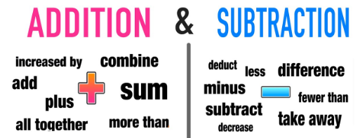
Addition and Subtraction

Slide 2
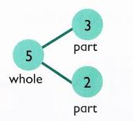
Models for addition
Combining two parts to make a whole
(part, part whole)
5
7
5 = 3 + 2
Notes:
Aggregation – one quantity to be combined with another (pushed together). When children have this image of addition, they are involved in a lot of counting. Count the first set, count the second set, push together, count the whole set.
Augmentation – Adding one quantity to another and counting on from the first number. This requires children to be able to ‘label the many one’ and to think of the 5 (for example) as ‘one five’ rather than ‘fives ones’ that need to be counted. Another important awareness at this stage is that it doesn’t matter whether you count on from the larger or smaller set – you are still counting the same combined set.
Counting on, on a bead bar or number line – bead bar provides a useful bridge from the cardinal sense (of both number and of the operation) and the ordinal.

Slide 3
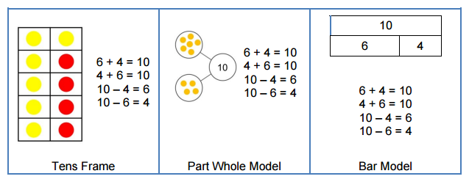
Number bonds to 10

Slide 4
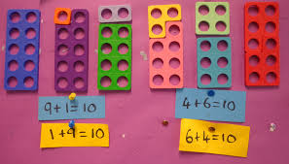
Numicon

Slide 5
Progression in addition: counting on
6 + 7 =
13
8
9
10
11
12
13
7
13
Start with larger number and count on

Slide 6
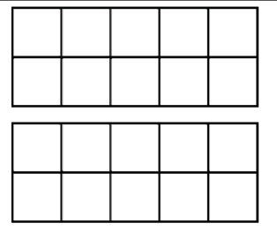
Regrouping to make 10
7 + 5
See the ‘story’ of a number and partition
5 = 3 + 2
7 + 5 = 12
Explain how you would mentally solve 8+6

Slide 7
Partitioning 6 to stop at 10
8 + 6 =
14
2
4
14
0
8
10
14
20
8 + 2 = 10
6 can be partitioned into 4 + 2
10 + 4 =
14
Notes:
Number track – division, intervals marked
Bridging to nearest 10

Slide 8
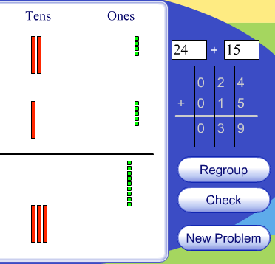
More than single digits
Using manipulatives
Base 10
Diennes
Notes:
http://www.harcourtschool.com/activity/elab2004/gr3/3.html

Slide 9
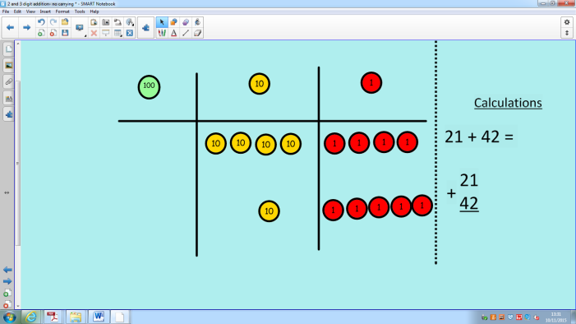
Leading to formal column method – no regrouping
44 + 15
Place value counters
+ 4
10 + 5
50 + 9 = 59
44
+15
59
50 9

Slide 10
With regrouping
1
1
1
10
10
1
1
2
5
1
1
+
4
7
10
10
1
1
10
1
10
1
1

Slide 11
With regrouping
2
5
10
10
1
1
1
1
+
4
7
10
10
1
1
1
10
1
1
10
1
1
1
60 12

Slide 12
With regrouping
20 + 5
40 + 7
60 + 12 = 72
2
5
10
10
+
4
7
10
10
1
10
10
1
7 2
10
1
Let’s have a go – either using diennes or PV counters
27 + 34
70 2

Slide 13
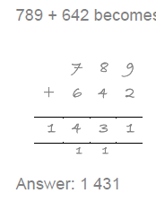
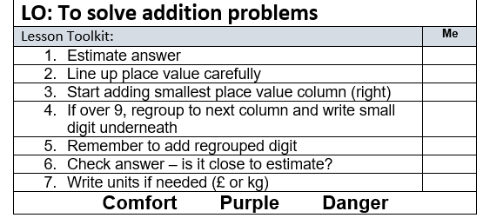
Expectations - Year 3 & 4
Column method – up to 4 digits
Let’s have a go…
687 + 594

Slide 14
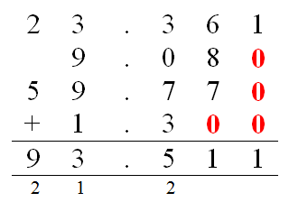
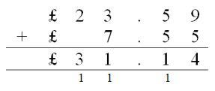
Expectations - Year 5 & 6
Column method – up to 3 decimal places
Let’s have a go…
62.5 + 387.928

Slide 15

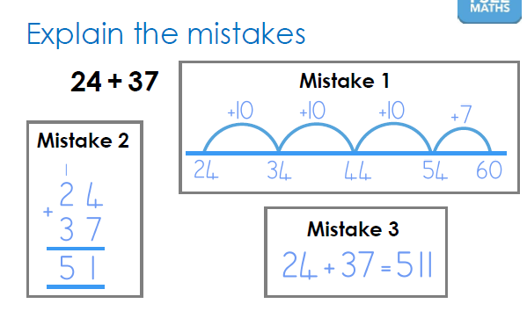

Slide 16
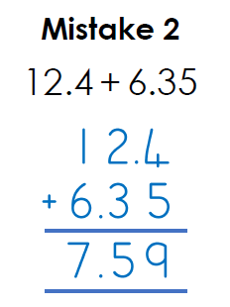

Slide 17
Looking at different ways of subtracting
Consider
21 – 18 = 21 – 3 =
Notes:
How would you do these differently?
Small gap or big gap?

Slide 18
21 – 18 =
Taking away
21 – 3 =

Slide 19
21 – 3 =

Slide 20
21 – 18 =
21 – 3 =

Slide 21
21 – 18 =
21 – 3 =
18
21 take away 3 = 18

Slide 22
Counting on
21 – 18 =
Notes:
Comparing to see the difference – what has been ADDED on (link with +)

Slide 23
21 – 18 =
Counting on
21 – 18 =

Slide 24
21 – 18 =
Counting on
21 – 18 =

Slide 25
Counting on
21 – 18 =
3
The difference between 21 and 18 is 3

Slide 26
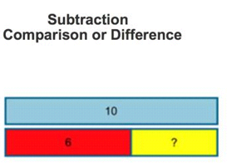
Part, part whole
Notes:
Inverse relationship with-

Slide 27
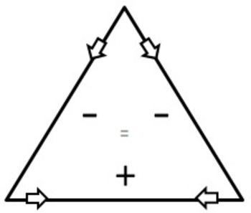
Strengthening the inverse relationship
10
8
2

Slide 28

Partitioning to make 10
14 - 6
See the ‘story’ of a number and partition
6 = 4 + 2

Slide 29
Partitioning to make 10
14 - 6
See the ‘story’ of a number and partition
6 = 4 + 2
14 - 4

Slide 30
Partitioning to make 10
14 - 6
See the ‘story’ of a number and partition
6 = 4 + 2
14 – 4 – 2 = 8
Explain how you would mentally solve 13-8

Slide 31
partitioning 8 to stop at 10
15 - 8 =
7
- 3
- 5
7
0
7
10
15
20
15 - 5 = 10
Need to know the ‘story’ of 8 and partition into 5 + 3
10 - 3 =
7

Slide 32
Building the skills – counting on from a multiple of 10
84 – 55 =
29
+5
+10
+10
+4
29
0 |  | 10 |  | 20 |  | 30 |  | 40 |  | 50 |  | 60 |  | 70 |  | 80 |  | 90 |  | 100
55
84
Building the skills – larger jumps
+5
+ 20
+4
29
0
10
20
30
40
50
60
70
80
90
100
55
84

Slide 33
Progression on the empty number line
83 – 47 =
36
36
+ 3
+ 10
+ 10
+ 10
+ 3
47
50
60
70
80
83

Slide 34
Progression on the empty number line
83 – 47 =
36
36
+ 3
+ 10
+ 10
+ 10
+ 3
47
50
60
70
80
83
+ 3
+ 30
+ 3
36
47
50
80
83

Slide 35
Progression on the empty number line
83 – 47 =
36
36
+ 3
+ 10
+ 10
+ 10
+ 3
47
50
60
70
80
83
+ 3
+ 30
+ 3
36
47
50
80
83
+ 3
+ 33
36
47
50
Let’s have a go
83

Slide 36
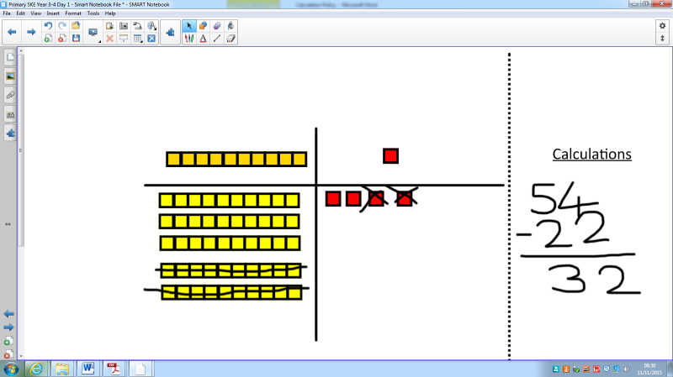
Column method – without regrouping / exchanging (not borrowing!)
50 + 4
- 20 + 2
30 + 2 = 32

Slide 37
Column method – with regrouping
10
10
10
10
10
10
7
2
10
10
10
1
1
-
4
7

Slide 38
Column method – with regrouping
1
1
1
10
10
1
10
1
1
1
10
10
1
6
1
7
2
10
1
10
1
10
1
1
-
4
7

Slide 39
Column method – with regrouping
1
1
1
10
10
10
1
1
10
10
6
7
2
10
1
10
10
-
4
7
5

Slide 40
Column method – with regrouping
1
1
1
10
10
10
1
1
6
7
2
1
10
-
4
7
2 5
Let’s have a go
63 - 28

Slide 41
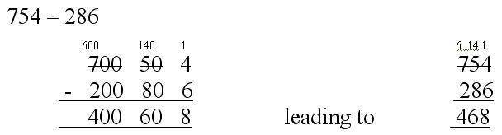
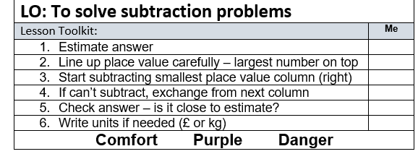
Column method – with regrouping / exchanging (not borrowing!)
Let’s have a go
803 - 527

Slide 42
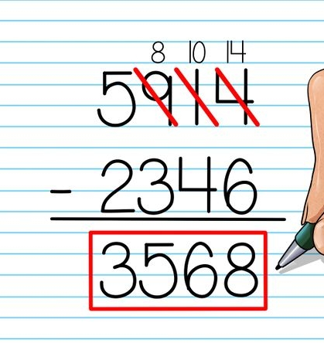
Expectations - Year 3 & 4
Column method – up to 4 digits

Slide 43
Expectations - Year 5 & 6
Column method – up to 3 decimal places

Slide 44
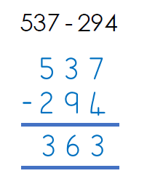

Slide 45
